Slide 1


FERROELECTRIC RAM
FerroElectric Random Access Memory
Sain Saburaj
MCA 23
Seminar Guide:
Vaisakh M
Notes:
Good [morning/afternoon/evening] everyone. My name is Sain Saburaj, and I am here to present my seminar on Ferroelectric Random Access Memory (FeRAM). This seminar is guided by Vaisakh M. Today, we will explore what FeRAM is, its working principle, advantages, limitations, applications, and future prospects.

Slide 2

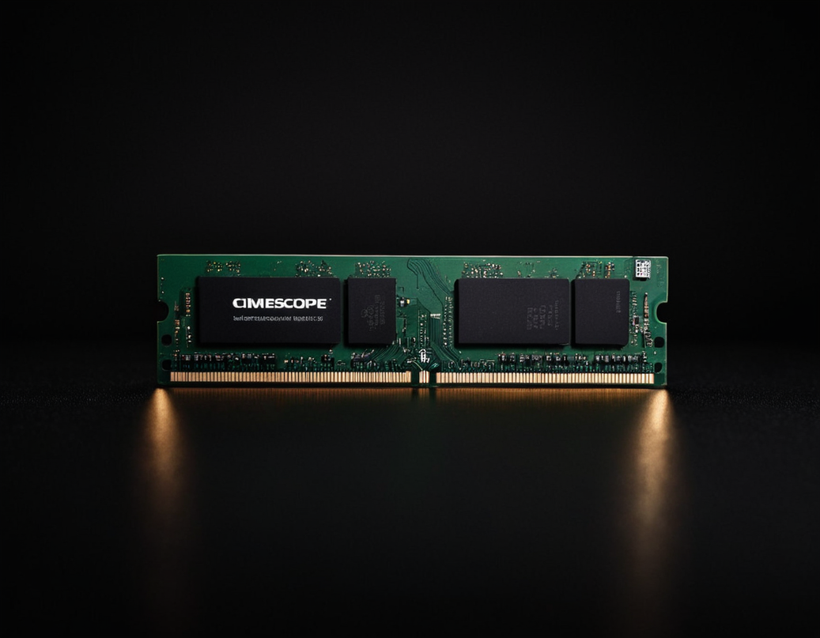
FERROELECTRIC RAM
WHAT IS RAM?
Random Access Memory
RAM (Random Access Memory) is a type of computer memory that stores data temporarily while the system is running. It works like a workspace where the processor quickly accesses information needed to run programs, open files, and perform tasks efficiently.
Volatile
High Speed
Multitasking
Temporary Storage
Notes:
Before diving into FeRAM, let’s first understand what RAM is.
RAM (Random Access Memory) is a volatile memory that temporarily stores data while the system is running.
It allows the processor to quickly access information needed for performing tasks.
Key characteristics of RAM:
Volatile – Loses data when power is off.
High speed – Provides fast read/write access.
Multitasking – Helps run multiple applications at once.
Temporary storage – Holds data only while the system is on.

Slide 3
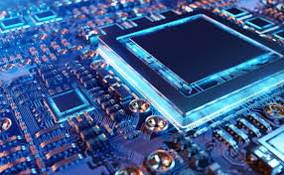
FERROELECTRIC RAM
INTRODUCTION
What is FerroElectric RAM?
Ferroelectric Random Access Memory (FeRAM) is a special type of memory that works like regular RAM but does not lose data when the power is turned off. It is a non-volatile memory, meaning it remembers everything even after shutting dow.
Non Volatile
Saves Power
Fast Writing Speed
Long Lasting
FeRAM stores data using a special material called a ferroelectric material.
Notes:
FeRAM (Ferroelectric RAM) is a non-volatile memory, meaning it retains data even when the power is off. It functions like regular RAM but is different because it does not lose stored information. FeRAM uses a ferroelectric material to store data, making it more energy-efficient and faster than traditional non-volatile memory. Key properties of FeRAM:
Normal RAM - Volatile – Loses data when power is off.
Non-volatile – Retains data without power.
Saves power – Consumes very little energy.
Fast write speed – Faster than Flash memory.
Long-lasting – Can handle millions of read/write cycles.

Slide 4
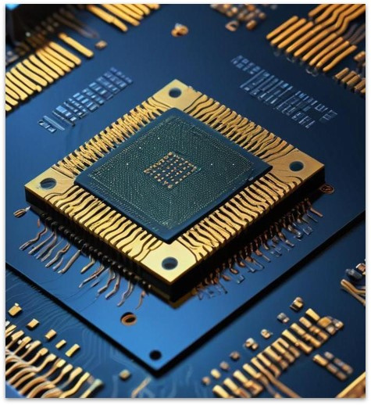
FERROELECTRIC RAM
KEY FEATURES
Non-volatile: Retains data even after power loss.
Speed: Faster than Flash memory.
Power Consumption: Consumes very little power, as it doesn’t need refreshing.
Endurance (Read/Write Cycles): Extremely high endurance, much better than Flash memory.
Storage Density: Lower storage density, making it less common for large-scale memory use.
Data Retention: Retains data for years without power, similar to Flash memory.
Notes:
FeRAM has several unique features that make it stand out.
Features:
Non-volatile – Data remains even after power loss.
Speed – Faster than Flash memory.
Low power consumption – Unlike DRAM, FeRAM does not require constant refreshing.
High endurance – Can handle millions of read/write cycles.
Storage density – Lower than DRAM, making it less common for large-scale storage. (A higher storage density means more data can fit in less space).
Data retention – Stores data for years, like Flash memory.
Why Does RAM Need Refreshing?
DRAM stores data in tiny capacitors (like small batteries).
These capacitors lose charge quickly, so the data fades away.
To prevent this, the computer refreshes (rewrites) the data thousands of times per second.
Uses more power because DRAM is constantly refreshed.
Slows down performance slightly, as refreshing takes time.

Slide 5
FERROELECTRIC RAM
KEY FEATURES
Cost & Scalability: More expensive due to complex manufacturing and lower storage density.
Read Mechanism: Destructive read – Reading data erases it, requiring an immediate rewrite.
Radiation Resistance: Highly resistant to radiation and electromagnetic interference, making it ideal for aerospace and military applications.
Temperature Stability: Performs reliably over a wide range of temperatures, useful for industrial and automotive applications.
Notes:
Cost & Scalability – More expensive due to complex manufacturing.
Read Mechanism – Destructive read; data is erased when read and needs to be rewritten.
Radiation resistance – Can withstand radiation, making it useful for space and military applications.
Temperature stability – Performs well in extreme conditions, ideal for industrial and automotive use.

Slide 6
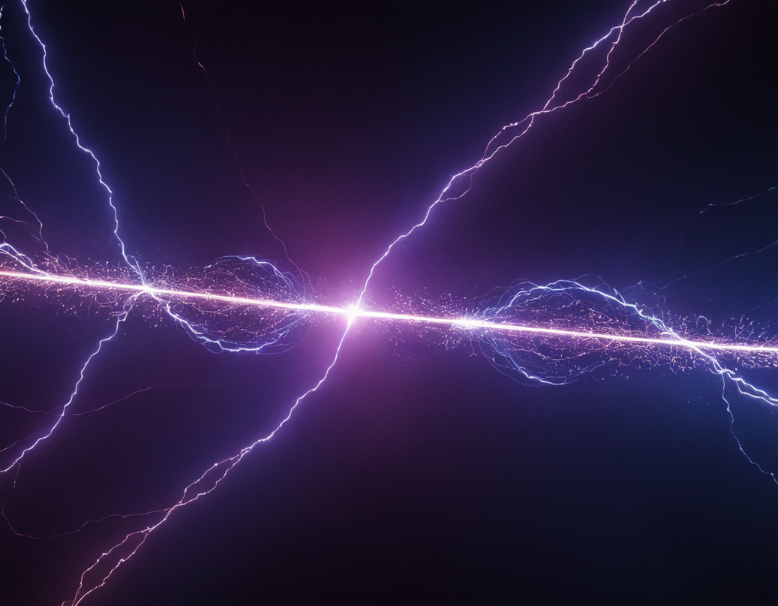
FERROELECTRIC RAM
FERROELECTRICITY
What is Ferroelectricity?
Ferroelectricity is a property of certain materials that allows them to have a permanent electric polarization, which can be reversed by applying an external electric field.
In Ferroelectric materials, electric dipoles align in a specific direction. When an electric field is applied, these dipoles switch, enabling data storage in FeRAM.
Notes:
What is Ferroelectricity?
It is a property of certain materials that allows them to have a permanent electric polarization that can be reversed by an electric field.
When an electric field is applied, these dipoles switch, enabling data storage in FeRAM.
In FeRAM, this polarization is used to store binary data (0s and 1s).
FeRAM uses a special material (ferroelectric) where dipoles can switch direction when electricity is applied.
The dipole's position represents data:
One direction = 1️⃣ (ON)
The opposite direction = 0️⃣ (OFF)
Since these dipoles stay in position even when power is off, FeRAM keeps data (unlike normal RAM, which forgets everything when turned off).

Slide 7
FERROELECTRIC RAM
FERROELECTRICITY
Ferroelectric Materials:
Barium Titanate (BaTiO₃): One of the first discovered ferroelectric materials, used in capacitors and sensors.
Lead Zirconate Titanate (PZT): The most widely used ferroelectric material in FeRAM, offering excellent polarization and stability.
Potassium Dihydrogen Phosphate (KH₂PO₄): Used in electro-optic and nonlinear optical applications due to its excellent ferroelectric and piezoelectric properties.
Notes:
Common Ferroelectric Materials: A FeRAM contains ferroelectric capacitor
Barium Titanate (BaTiO₃) – Used in capacitors and sensors.
Lead Zirconate Titanate (PZT) – The most common material in FeRAM, known for its excellent stability.
Potassium Dihydrogen Phosphate (KH₂PO₄) – Used in optical and piezoelectric applications.
What is Piezoelectricity?
Some special materials can generate electricity when pressed or bent.
This is called piezoelectricity, and it’s used in many cool technologies!

Slide 8
FERROELECTRIC RAM
FERROELECTRICITY
Applications of Ferroelectric Materials:
FeRAM (Ferroelectric RAM): Used in low-power, high-speed, and durable memory storage solutions.
Non-Volatile Memory: Applied in embedded systems, smart cards, and automotive electronics.
Piezoelectric Devices: Utilized in sensors and ultrasound transducers.
Energy Harvesting: Converts mechanical energy into electrical energy in self-powered devices.
Electro-Optic Applications: Used in displays and photonic devices for optical data processing.
Notes:
Ferroelectric materials are used in various fields:
FeRAM – Non-volatile, high-speed memory.
Non-volatile memory – Used in smart cards, embedded systems, and automotive electronics.
Piezoelectric devices – Found in ultrasound sensors and actuators.
Energy harvesting – Converts mechanical energy into electrical energy.
Electro-optic applications – Used in displays and optical data processing.

Slide 9

FERROELECTRIC RAM
STRUCTURAL COMPOSITION
FeRAM (Ferroelectric RAM) is built similarly to regular RAM but has a special component that makes it different. Each FeRAM memory cell consists of two main parts:
A Transistor: This acts like a switch, controlling how data is stored and read.
A Ferroelectric Capacitor: Instead of a regular capacitor, FeRAM uses a special one made of ferroelectric material (like PZT – Lead Zirconate Titanate). This material can switch its electric charge direction, helping FeRAM remember data even when power is turned off.
Notes:
FeRAM is structured similarly to DRAM but has a ferroelectric capacitor instead of a standard capacitor.
Each FeRAM memory cell consists of:
A transistor – Controls data storage and access.
A ferroelectric capacitor – Stores data using polarization instead of charge.
The ferroelectric material helps FeRAM retain data even without power, unlike conventional RAM.

Slide 10
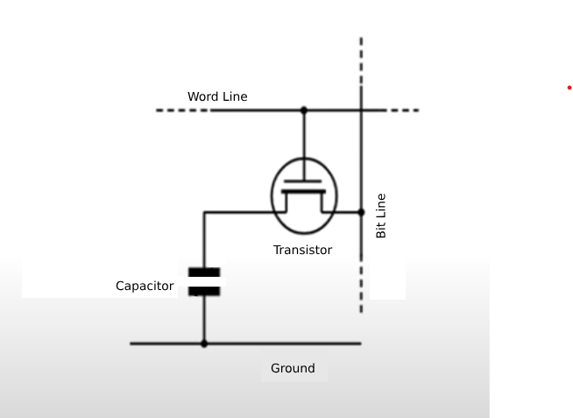
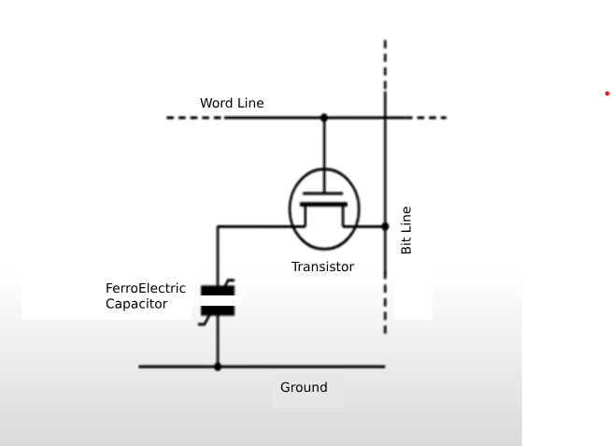
FERROELECTRIC RAM
STRUCTURAL COMPOSITION
R A M
FeRAM
Notes:
A RAM memory cell is like a tiny storage box that holds data while the computer is running. It has these important parts:
1️⃣ Word Line (WL) – Tells the memory cell when to store or send data. 2️⃣ Bit Line (BL) – Sends or receives the data. 3️⃣ Transistor (Switch) – Controls when data flows in or out. 4️⃣ Capacitor – Holds the data temporarily like a small battery (used in DRAM). 5️⃣ Ground (GND) – Completes the circuit so electricity can flow properly.
Since RAM needs refreshing to keep the data, it uses more power.
An FeRAM memory cell is like a tiny switch that stores data. It has these important parts:
1️⃣ Word Line (WL) – Turns the memory cell ON or OFF. 2️⃣ Bit Line (BL) – Sends or receives the data. 3️⃣ Transistor – Works like a gate, allowing data to move when needed. 4️⃣ Ferroelectric Capacitor – Keeps the data even when power is off. 5️⃣ Ground (GND) – Completes the circuit so electricity can flow properly.
FeRAM works fast, saves power, and keeps data safe even when the computer is turned off! 😊

Slide 11
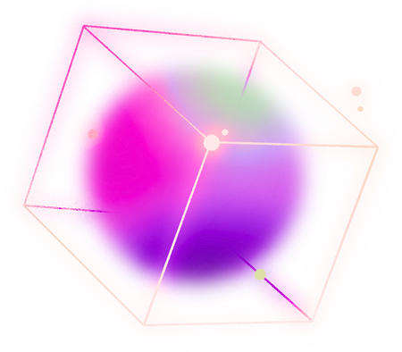
FERROELECTRIC RAM
FERAM VS. CONVENTIONAL RAM
FeRAM
Non-volatile: Retains data after power loss.
Fast read/write speeds, comparable to DRAM.
Low power consumption: No need for constant refreshing.
High endurance: Can handle millions of read/write cycles.
Higher cost: More expensive due to complex fabrication.
Used in smart cards, IoT devices, automotive systems, etc.
Conventional RAM (DRAM/SRAM)
Volatile: Data is lost when power is off.
DRAM is fast, but FeRAM matches its speed in some cases.
Higher power consumption: Needs continuous refreshing (DRAM).
Limited endurance: Wear out faster than FeRAM (Flash memory).
Lower cost: More scalable and widely used.
Used in PCs, gaming consoles, high-speed caches, etc.
Notes:
✅ FeRAM:
Non-volatile, retains data without power.
Fast read/write speeds, similar to DRAM.
Lower power consumption, no need for refreshing.
High endurance, can handle millions of write cycles.
✅ Conventional RAM (DRAM/SRAM):
Volatile, loses data when power is off.
DRAM needs constant refreshing, consuming more power.
Higher storage density, making it more common in large applications.
Cheaper & widely used in PCs and gaming consoles.

Slide 12

FERROELECTRIC RAM
OPERATIONAL MECHANISM
Stores Data Using Polarization: A ferroelectric capacitor switches between two stable polarization states (+ or -), representing 1s and 0s.
Writing Data: Applying voltage sets the polarization direction, storing the required bit.
Reading Data (Destructive Read): The capacitor's state is checked, but reading erases the data, requiring an automatic rewrite.
Fast & Energy-Efficient: Unlike DRAM, FeRAM doesn’t need constant refreshing, reducing power consumption and access time.
Non-Volatile: Data remains intact even without power, making it a reliable alternative to traditional RAM.
Notes:
How It Works:
1️⃣ The dipoles are like tiny switches inside the ferroelectric capacitor. 2️⃣ When no voltage is applied, they stay in their current position. 3️⃣ When electricity (voltage) is applied, the electric field pushes them to switch direction:
One direction = "1" (ON).
Opposite direction = "0" (OFF). 4️⃣ When the power is turned off, the dipoles stay in place, keeping the data safe!
The ferroelectric material inside FeRAM allows dipoles to flip when voltage is applied.
Once flipped, they remain in that state until changed again, making FeRAM non-volatile (keeps data even without power).
Energy Efficient – Does not require constant refreshing like DRAM.
Non-volatile – Retains data even when power is off.

Slide 13
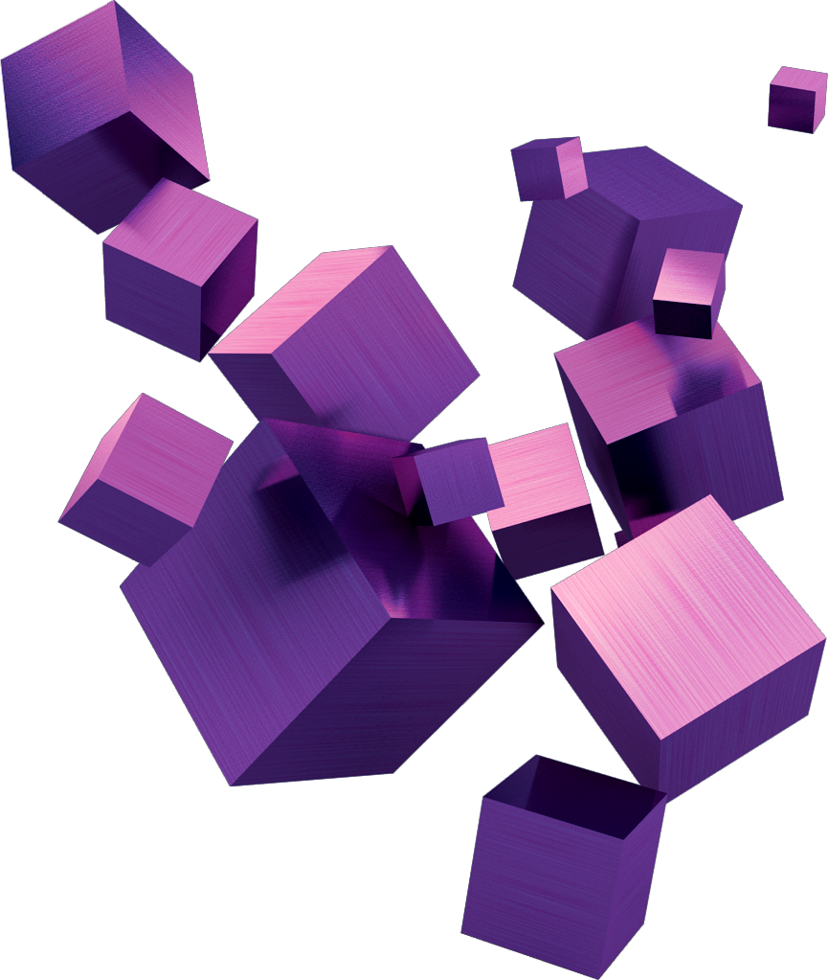
FERROELECTRIC RAM
TYPES OF FERROELECTRIC RAM
1T1C FeRAM: Uses one transistor and one capacitor per cell, offering fast operation but with limited scalability and higher power efficiency.
2T2C FeRAM: Has two transistors and two capacitors per cell, enhancing reliability and reducing read errors but increasing chip size.
FeFET-Based FeRAM: Uses a ferroelectric transistor instead of a capacitor, allowing non-destructive reads, better scalability, and compatibility with advanced semiconductor processes.
Notes:
Different types of FeRAM architectures:
1T1C (One-Transistor One-Capacitor) – Simple design, fast but has scalability issues.
2T2C (Two-Transistor Two-Capacitor) – More reliable but uses more space.
FeFET-Based FeRAM – Uses ferroelectric transistors, enabling non-destructive reads and better scalability.

Slide 14
FERROELECTRIC RAM
INTERACTION WITH CPU AND GPU
With CPU:
Non-volatile storage reduces boot time.
Fast read/write speeds improve performance.
Low power consumption enhances energy efficiency.
Persistent caching ensures reliable data retention.
Simplifies system architecture by reducing backup needs.
With GPU:
Fast data access improves rendering & AI processing.
Lower power consumption benefits battery-powered devices.
Real-time data updates enhance parallel computing.
Persistent buffering ensures data retention during failures.
⚠ Challenges: Lower storage density & destructive read mechanism require further advancements.
Notes:
✅ With CPU:
FeRAM’s non-volatile nature helps retain data after shutdown, reducing boot times.
Provides fast access speeds, improving performance.
Low power consumption benefits battery-powered devices.
Persistent caching prevents data loss during power failures.
✅ With GPU:
FeRAM offers fast data access, improving rendering and AI processing.
Low power usage reduces GPU energy consumption.
Real-time data updates improve efficiency in parallel computing.
Persistent buffering ensures stable data storage even during failures.
⚠ Challenges: FeRAM has lower storage density and a destructive read process, requiring further advancements.

Slide 15

FERROELECTRIC RAM
ADVANTAGES
High Speed
Faster read and write operations compared to Flash memory.
Radiation Resistance
Performs well in extreme conditions, ideal for aerospace and medical applications.
High Endurance
Can withstand millions to billions of read/write cycles, unlike Flash memory.
Low Power Consumption
Retains data without constant power, improving energy efficiency.
Non-Volatile
Stores data even after power is turned off, making it reliable for embedded systems.
Notes:
Radiation Resistant – Performs well in space and medical devices.
High Speed – Faster read/write than Flash memory.
Low Power Consumption – No refreshing needed.
High Endurance – Can handle billions of write cycles.
Non-Volatile – Stores data even after power is turned off.

Slide 16

FERROELECTRIC RAM
LIMITATIONS
Lower Storage Density
FeRAM has a lower bit density compared to Flash memory, limiting its use in high-capacity storage applications
Scaling Challenges
Reducing the cell size while maintaining performance and reliability is difficult, limiting future advancements.
Higher Manufacturing Cost
The fabrication process involves specialized materials like PZT, making production expensive.
Destructive Read Process
Reading data alters the polarization state, requiring a rewrite operation, which adds complexity.
Limited Commercial Adoption
Due to cost and density limitations, FeRAM has not widely replaced traditional memory technologies.
Notes:
Scaling Challenges – Hard to reduce cell size while maintaining reliability.
Lower Storage Density – Not suitable for high-capacity storage.
Destructive Read Process – Requires a rewrite after reading.
Higher Manufacturing Cost – Expensive due to special materials.
Limited Commercial Adoption – Not widely used in mainstream memory applications.

Slide 17


FERROELECTRIC RAM
CURRENT APPLICATIONS
Embedded Systems: Used in automotive and industrial control systems
Medical Devices: Low power consumption and durability
Smart Cards & Security Systems: FeRAM’s fast write speeds and endurance
IoT Devices: Efficient energy use and fast access
Aerospace & Defense: Reliable operation in extreme environments
Notes:
✅ Embedded Systems:
FeRAM is widely used in automotive and industrial control systems where high reliability and fast data storage are crucial.
Unlike traditional memory, FeRAM’s non-volatility ensures critical data is not lost in case of power failures.
✅ Medical Devices:
FeRAM’s low power consumption makes it perfect for implantable medical devices, such as pacemakers and hearing aids.
In patient monitoring systems, FeRAM ensures continuous data storage without frequent battery replacements.
✅ Smart Cards & Security Systems:
FeRAM is ideal for secure authentication and financial transactions because of its fast write speeds and high durability.
Used in credit cards, ID cards, and encryption systems, where rapid and secure data storage is required.
✅ IoT Devices:
In IoT applications, sensors and edge computing devices require efficient energy use and fast data access.
FeRAM helps improve performance in smart home devices, industrial IoT, and real-time monitoring systems.
✅ Aerospace & Defense:
FeRAM is used in satellites, avionics, and military applications because it can withstand extreme temperatures, radiation, and harsh environments.
Unlike traditional RAM, FeRAM ensures data integrity and reliability even in space missions and defense systems.

Slide 18

FERROELECTRIC RAM
FUTURE PROSPECT
Increased Storage Density: Research aims to enhance FeRAM’s capacity for broader adoption.
Non-Destructive Read Mechanism: Advancements to eliminate the need for rewrite cycles after reading.
Cost Reduction: Innovations in materials and manufacturing to make FeRAM more competitive.
Integration in AI & Edge Computing: Potential use in AI-driven and real-time processing applications.
New Ferroelectric Materials: Exploring alternatives beyond PZT for improved efficiency.
Expansion in IoT & Wearables: FeRAM’s low power consumption makes it ideal for next-gen devices.
Notes:
✅ Increased Storage Density:
Current FeRAM faces limitations in storage capacity compared to DRAM and Flash memory.
Ongoing research aims to increase FeRAM's density, making it a viable option for larger-scale applications like data centers and consumer electronics.
✅ Non-Destructive Read Mechanism:
Traditional FeRAM has a destructive read process, meaning data must be rewritten after every read.
Scientists are developing new architectures to enable non-destructive reads, improving speed, efficiency, and durability.
✅ Cost Reduction:
One of FeRAM’s biggest challenges is high production costs due to specialized materials.
Innovations in manufacturing techniques and new material research aim to reduce costs, making FeRAM more affordable and commercially competitive.
✅ Integration in AI & Edge Computing:
With AI and real-time processing becoming mainstream, FeRAM’s fast access speeds and energy efficiency make it a strong candidate for use in AI accelerators and edge computing devices.
✅ New Ferroelectric Materials:
Current FeRAMs mostly use PZT (Lead Zirconate Titanate) as the ferroelectric material.
Researchers are exploring new materials like Hafnium Oxide (HfO₂) to improve scalability, efficiency, and compatibility with modern semiconductor technology.
✅ Expansion in IoT & Wearables:
FeRAM’s low power consumption and durability make it perfect for next-gen IoT devices and wearables.
It can be used in smart sensors, medical wearables, and industrial automation where power efficiency is critical.

Slide 19

FERROELECTRIC RAM
CONCLUSION
FeRAM bridges the gap between high-speed volatile memory and non-volatile storage.
Offers advantages like fast write speeds, low power consumption, and high endurance.
Challenges exist, including lower storage density and higher production costs.
Continued research is driving improvements in scalability, efficiency, and cost-effectiveness.
Future potential in AI, IoT, and next-gen computing makes FeRAM a promising technology
Notes:
✅ "To summarize, FeRAM is a promising memory technology that combines the speed of RAM with the non-volatility of Flash memory."
It offers fast read/write speeds, low power consumption, and high endurance, making it ideal for applications in automotive, medical, IoT, and security systems.
Unlike traditional RAM, FeRAM retains data even after power loss, making it highly reliable.
Despite its lower storage density and higher cost, ongoing research in new materials, non-destructive read mechanisms, and cost-efficient manufacturing is making FeRAM more competitive.
With its potential in AI, edge computing, and next-generation electronics, FeRAM could play a key role in future memory solutions.

Slide 20

FERROELECTRIC RAM
THANK YOU
I sincerely appreciate your time and attention throughout this seminar. Ferroelectric RAM (FeRAM) is a promising memory technology that balances speed, energy efficiency, and non-volatility, paving the way for advancements in computing. I hope this session provided valuable insights into its potential and future applications.
Sain Saburaj
MCA 23
Seminar Guide:
Vaisakh M

